Slide 1


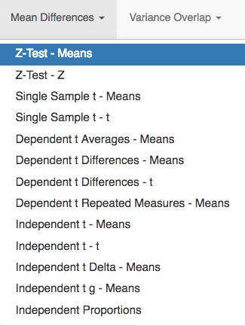
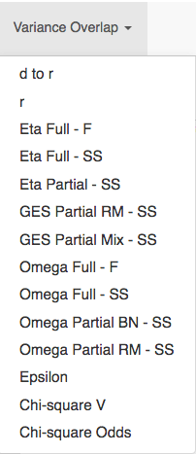
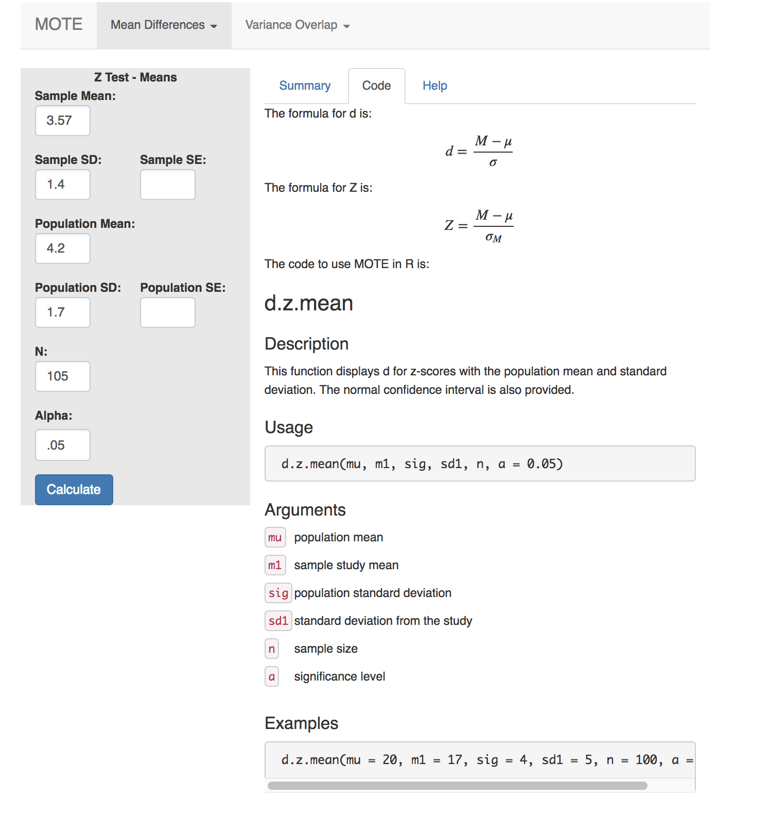
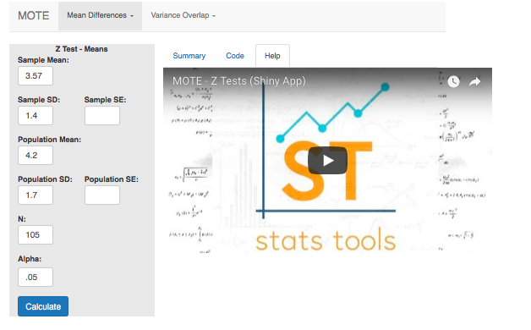
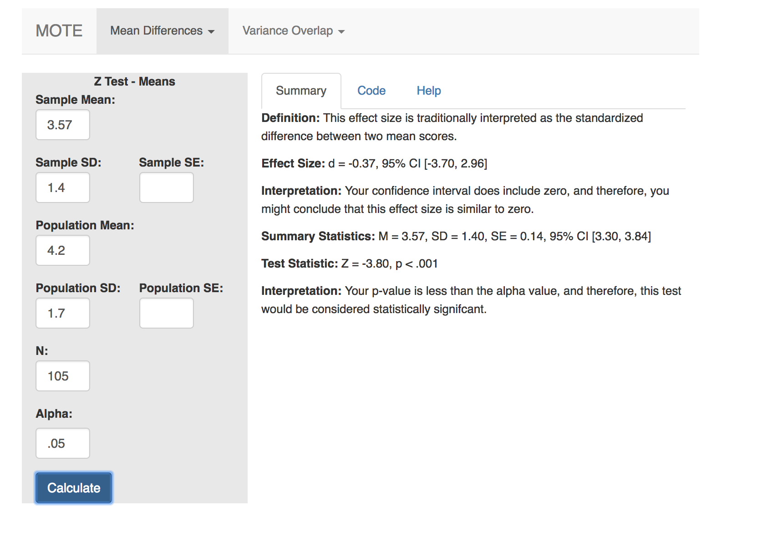

Magnitude of the Effect: An Application for Effect Size Calculation
for Research and Statistics Classes
Erin M. Buchanan, Ph.D., Amber Gillenwaters, William Padfield, Abigail Van Nuland, Addie Wikowsky
Missouri State University
Glass¹ and Cohen² believed that effect sizes were integral to statistical interpretation. The APA Task Force on Statistical Inference has long advocated for the inclusion of effect sizes³. Many statisticians suggest that a report of the effect size is necessary to maintain the integrity of research, a topic that has recently garnered great debate⁴ due to the prevalence of poor replicability and other all too common failures in research. However, the vast majority of peer-reviewed, published academic studies stop short of reporting effect sizes and confidence intervals⁵. Often, an overreliance on p-values conceals the fact that the study is underpowered⁶; a test may be statistically significant, yet practically inconsequential⁴. The effect size is a measure of the magnitude of the effect. How much did grades improve after an intervention? To what degree were symptoms reduced after a treatment? Effect size supplements p-values by providing this critical information. For the amateur researcher, selecting an appropriate hypothesis test can be a challenging process to understand, with the approximation of the effect size only adding to the difficulty. Providing student researchers with a streamlined tool to calculate effect size and understand the interpretation of test statistics will serve to benefit the field of psychological research over time. Our team designed our effect size tool with Shiny⁷, a package in R⁸. The application relies on mathematical operations provided by MOTE (Magnitude of the Effect), a versatile package developed by Buchanan, Scofield, and Valentine⁹. To begin, the user simply selects the research design and corresponding effect size with intuitive drop-down menus (as seen below). The output includes a helpful description, a video tutorial, and statistics in APA style, including the effect size and the confidence interval. This application is designed for future implementation in statistics classrooms at the undergraduate and graduate level. Student and faculty feedback during beta testing has been overwhelmingly positive. We believe this application will aid in both teaching and learning statistics and research methods.
Summary Page
Code Page
Help Page
Pictured above are all available functions in MOTE.
In the help panel, the user is able to watch videos that will help the user interpret their data output and find the right numbers to put into MOTE. The package options include SPSS, JASP, and SAS. All videos are hosted by Dr. Buchanan’s “Statistics of DOOM” YouTube channel as part of the “StatsTools” series.
The Code tab displays the formulae as well as the R syntax used to calculate the selected effect size. Additionally, the user will see a description of how the effect size is calculated, required arguments for the selected effect size function, and examples of how the function is structured in R. The functions and code are from the MOTE library⁹.
References
Glass, G.V., B. McGaw, and M.L. Smith (1981), Meta-analysis in social research. Sage: Beverly Hills.
Cohen, J. (1990). Things I have learned (so far). American Psychologist, 45(12), 1304-1312. doi: 10.1037//0003-066x.45.12.1304
Wilkinson, L. & American Psychological Association Task Force on Statistical Inference. (1999). Statistical methods in psychology journals: Guidelines and explanations. American Psychologist, 54, 594-604. doi: 10.1037//0003-066x.54.8.594
Fritz, A., Scherndl, T., & Kühberger, A. (2013). A comprehensive review of reporting practices in psychological journals: Are effect sizes really enough?. Theory & Psychology, 23(1), 98-122. doi: 10.1177/0959354312436870
Cumming, G. (2014). The new statistics: Why and how. Psychological science, 25(1), 7-29. doi: 10.1177/0956797613504966
Halsey, L. G., Curran-Everett, D., Vowler, S. L., & Drummond, G. B. (2015). The fickle p value generates irreproducible results. Nature Methods, 12(3), 179-185. doi: 10.1038/nmeth.3288
Chang, W., Cheng, J., Allaire, J.J., Xie, Y., & McPherson, J. (2017). shiny: Web Application Framework for R. R package version 1.0.5.
R Core Team (2013). R: A language and environment for statistical computing. R Foundation for Statistical Computing, Vienna, Austria.
Buchanan, E., Scofield, J. and Valentine, K.D. (2017). MOTE: Effect Size and Confidence Interval Calculator. R package version 0.0.0.9100.
After the user inputs their data, the summary page provides everything the user needs to interpret the statistics. This includes a definition of the test, the appropriate effect size measure, confidence interval of the effect size, summary, and test statistics with interpretations of all these values.
For more information, please contact Dr. Erin Buchanan at: ErinBuchanan@MissouriState.edu
Check out all the code at: https://github.com/doomlab/shiny-server/tree/master/MOTE
Check out the YouTube Channel at: http://www.youtube.com/c/StatisticsofDOOM
Check out StatsTools at: http://statstools.com/

